Slide 1
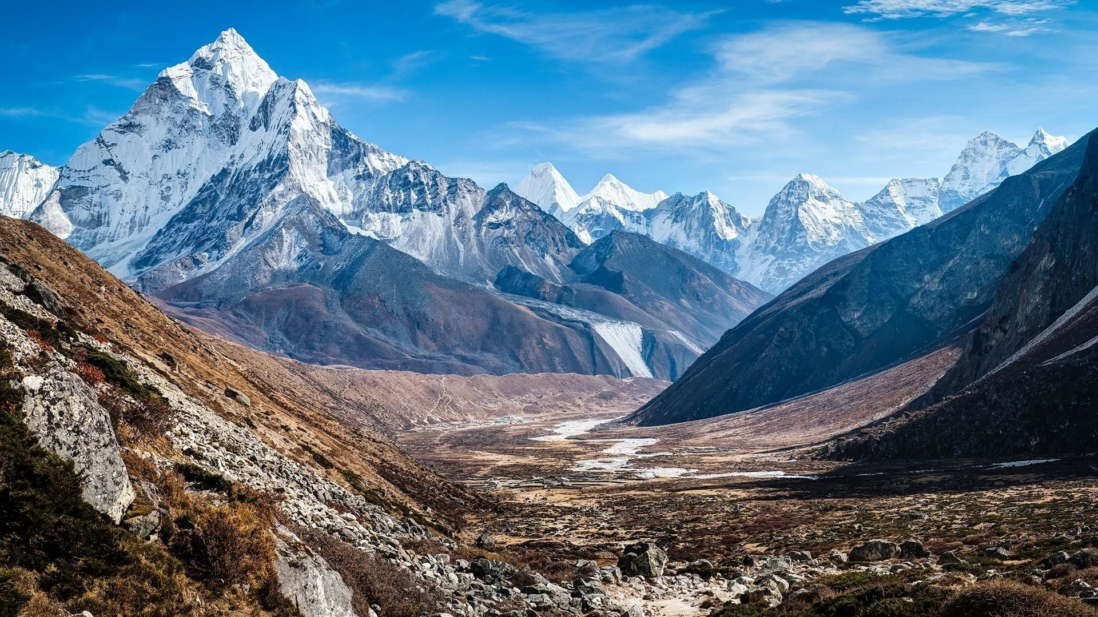

Get In Touch With Us
Himalaya Data Analysis
Analysis and visualization of Himalayan database
Jaime Muñoz Martín
Data Analytics OCT2022
Ironhack School Tech

Slide 2
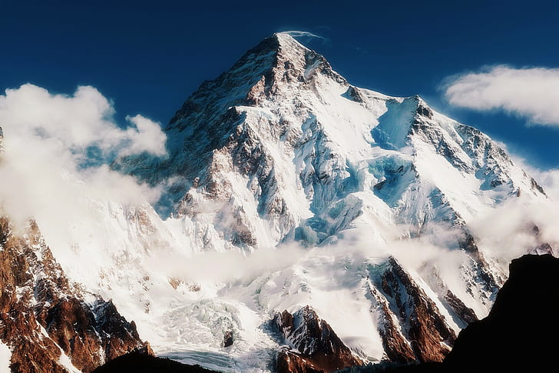
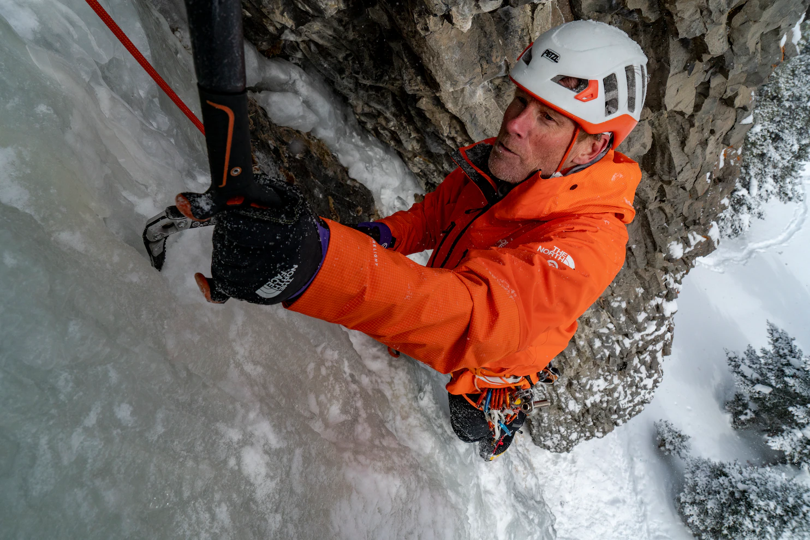
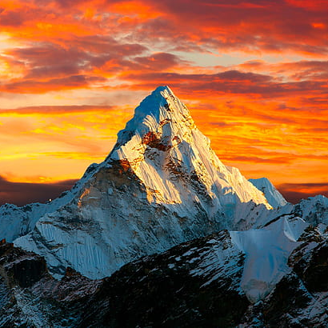
Data Preparation
Extraction
Transformation
Visualization
Kaggle dataset based on the expedition archives of Elizabeth Hawley
Transform data and feed the database with peak coordinates
Information display Peak mapping

Slide 3
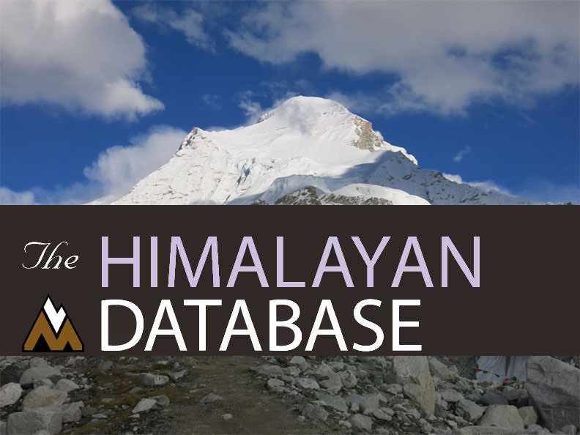
Transformation
Himalayan Database
The database transformation consists of cleaning the data and feeding up with information I would like to use upon my analysis.
Database consists of 4 main tables:
Deaths.csv
Expeditions.csv
Peaks.csv
Summiters.csv
All of them were related with a peak_id.

Slide 4
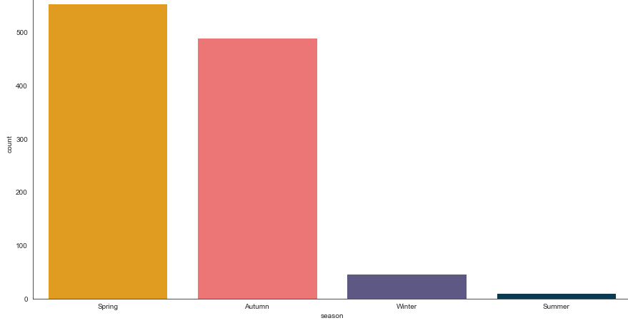
Visualization
Deaths by Season
A simple view of deaths grouped by season

Slide 5
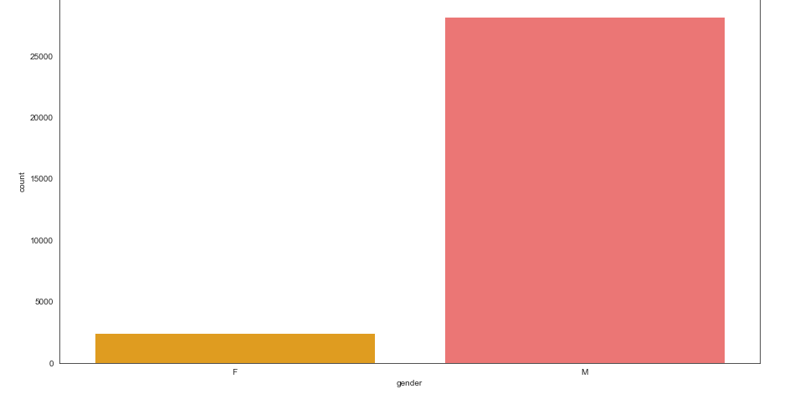
Visualization
Expeditions by gender
A simple view of hikers grouped by gender

Slide 6
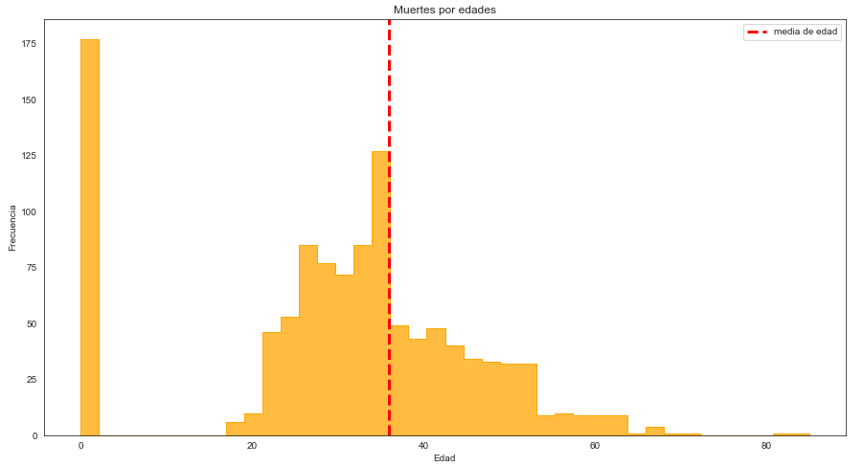
Visualization
Deaths by age
From all the deaths that were registered in the database, the count of deaths grouped by age.
The mean of the people death is 36 year old

Slide 7
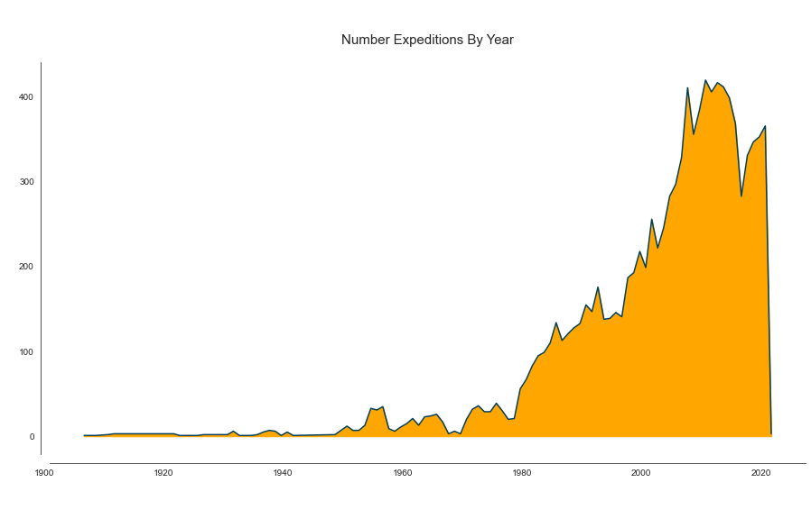
Visualization
Nº Expeditions by year
The total number of expeditions that have been taken each year since the data was collected until 2020.

Slide 8
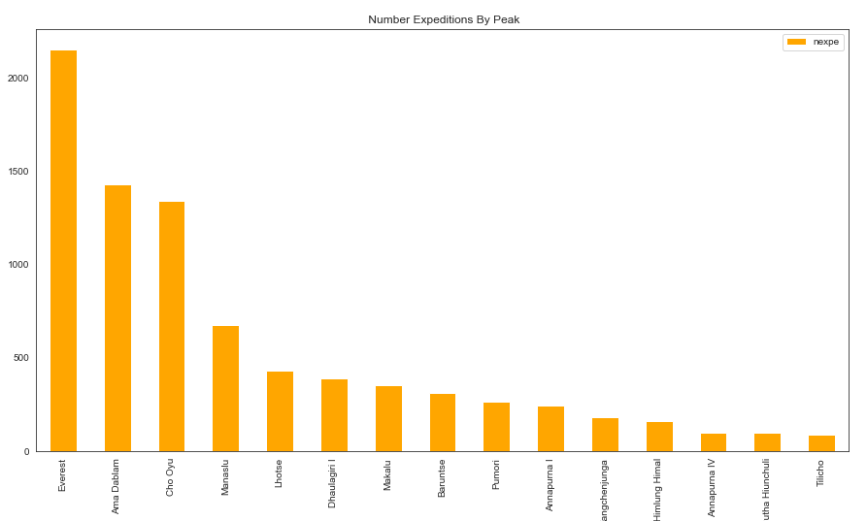
Visualization
Nº expeditions by Peak
Simple view of the 15 most visited peaks

Slide 9
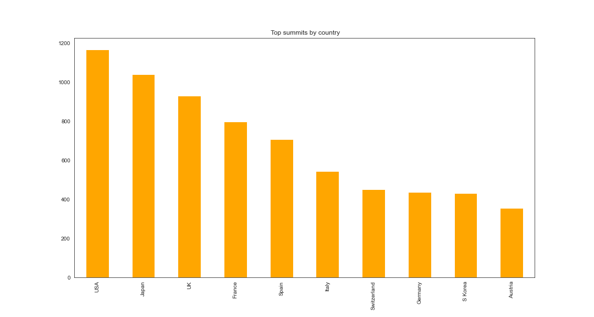










Visualization
Top summits by country
These are the total amount of peaks conquered by country.
USA, JAPAN and UK as the top 3

Slide 10
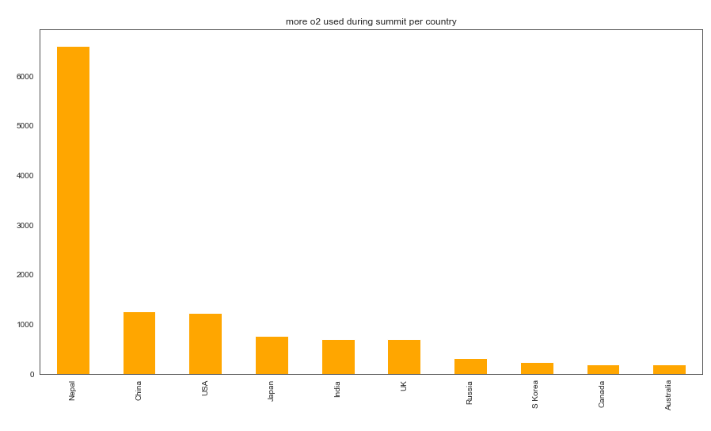
Visualization
¿Who uses more oxygen during summits?
It´s common to see that Nepalis are the ones that use more oxygen because they assist in almost all the expeditions as sherpas.

Slide 11
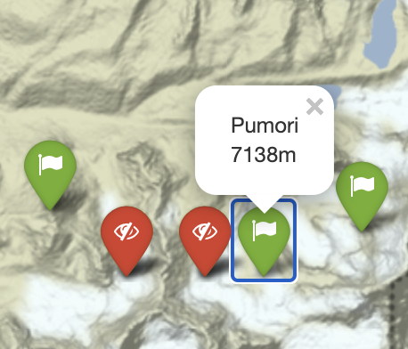
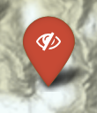


Visualization
FOLIUM
I have used Folium for mapping the peaks. Actually I have found 200 peaks location but in the future I expect to include the full 461 peaks of the database
Not climbed
+8000 meters
Climbed

Slide 12
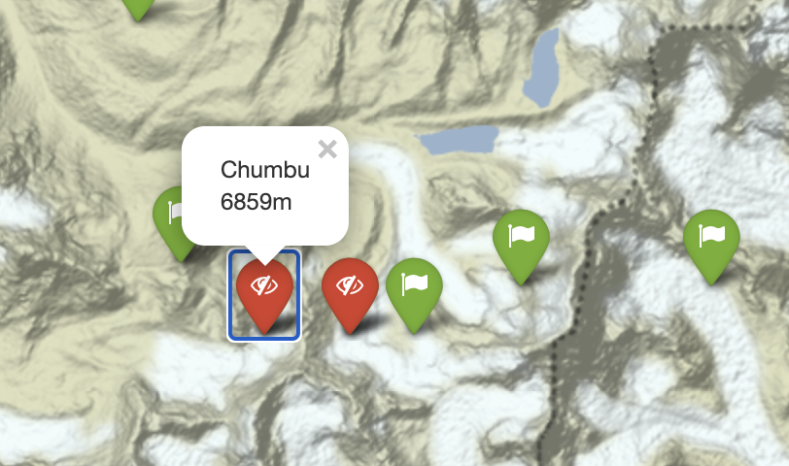
Visualization
FOLIUM
I have used Folium for mapping the peaks. Actually I have found 200 peaks location but in the future I expect to include the full 461 peaks of the database
Not climbed
+8000 meters
Climbed

Slide 13
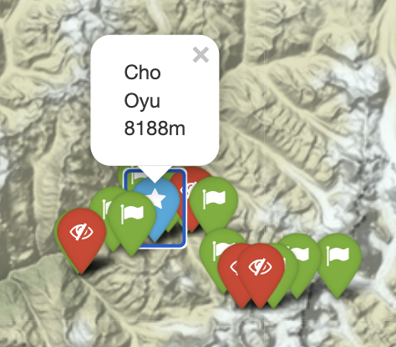
Visualization
FOLIUM
I have used Folium for mapping the peaks. Actually I have found 200 peaks location but in the future I expect to include the full 461 peaks of the database
Not climbed
+8000 meters
Climbed

Slide 14

Future expectations
Summit predictor
For the future I expect to develop a predictor that show you the probability of doing summit based on certain variables.
35%
64,3%

Slide 15
Thanks

